Slide 1
FINANCIAL ANALYSIS OF DIVIS LABORATORIES
Submitted to:
Prof. Gopinath N

Slide 2
OUR TEAM
ARYAN BANSAL
ARNAB MONDAL
AJAY RAJKUMAR
20BCE1591
20BCE1394
20BAI1020
DHARANI R
GOVIND AGARWAL
KRITIKA JINDAL
20BCE1897
20BCE1618
20BCE1913

Slide 3
AGENDA
INTRODUCTION
01
COMPANY PROFILE
02
REVIEW OF LITERATURE
03
ANALYSIS
04
Brief description of the project
Description about the company
Review of the literature available of the company finances
Financial Analysis of the company

Slide 4
AGENDA
CONCLUSION
05
REFERENCES
06
Conclusion on the financial situation of the company

Slide 5

INTRODUCTION
The aim of this project is to determine and evaluate current financial condition of a company and predict its future performance in the market. In order to evaluate performance of the company annual report and auditor report along with financial statements are analyzed.
For this project we have selected Divi's Laboratories Limited, which are engaged in manufacturing and sale of active pharmaceutical ingredients (APIs) and Intermediates. Few of its products include Generic APIs, Intermediates, Peptide Building Blocks and Carotenoids.

Slide 6

COMPANY PROFILE
Divi’s Laboratories Ltd is an Indian based manufacturer of Active Pharmaceutical Ingredients (APIs) and Intermediates. The company is engaged in manufacture of leading generic compounds Nutraceutical ingredients and custom synthesis of APIs and intermediates for global innovator companies. Divis is among the largest pharmaceutical companies in India with a portfolio of 120 products across diverse therapeutic areas.

Slide 7
REVIEW OF LITERATURE
In the auditor's report, they have audited the accompanying standalone financial statements of DIVI'S LABORATORIES LIMITED ("the Company"), which comprise the Balance Sheet as at 31st March, 2021, the Statement of Profit and Loss and the Cash Flow Statement for the year then ended, and a summary of significant accounting policies and other explanatory information.
According to the auditor's opinion standalone financial statements give the information required by the Act in the manner so required and give a true and fair view in conformity with the accounting principles.

Slide 8
OBJECTIVES
The financial statement of Company "Divis Laboratories" was analyzed using tools, analytical techniques, and appropriate methodologies during this study.
MAIN PURPOSE
FINANCIAL STATEMENT
The main purpose of this study is to determine, forecast and evaluate the best of economic conditions and company’s performance in the future.
ANALYSIS
An examination of the auditor's report was conducted, and the company's financial records were compared for five consecutive years along with inter and intra firm comparison.

Slide 9
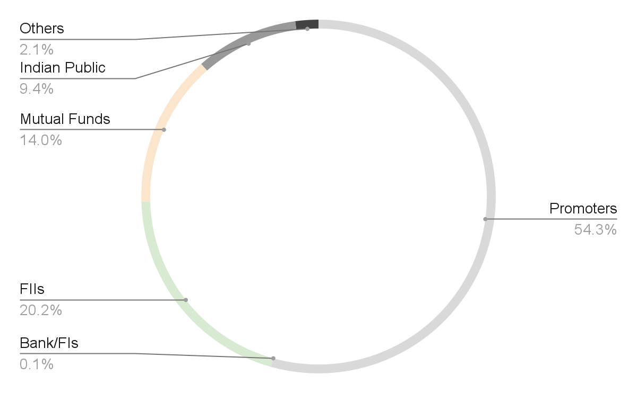
SHAREHOLDING PATTERN

Slide 10
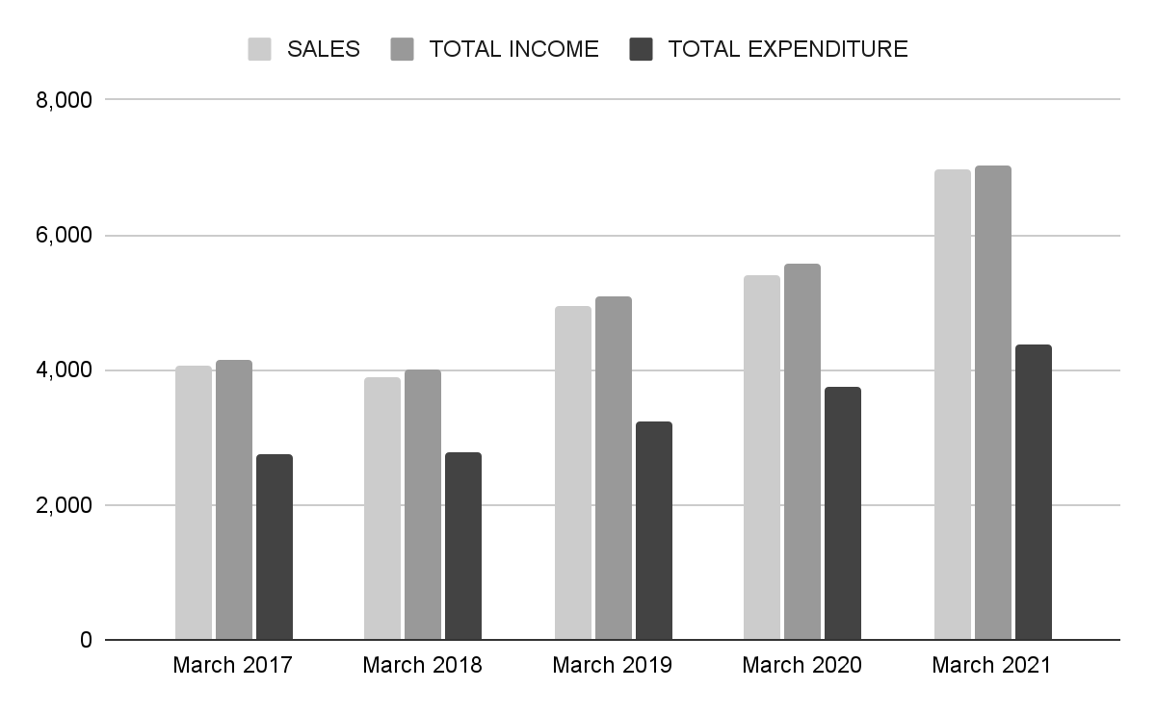
SALES vs TOTAL INCOME vs TOTAL EXPENDITURE
SOURCE: Moneycontrol

Slide 11
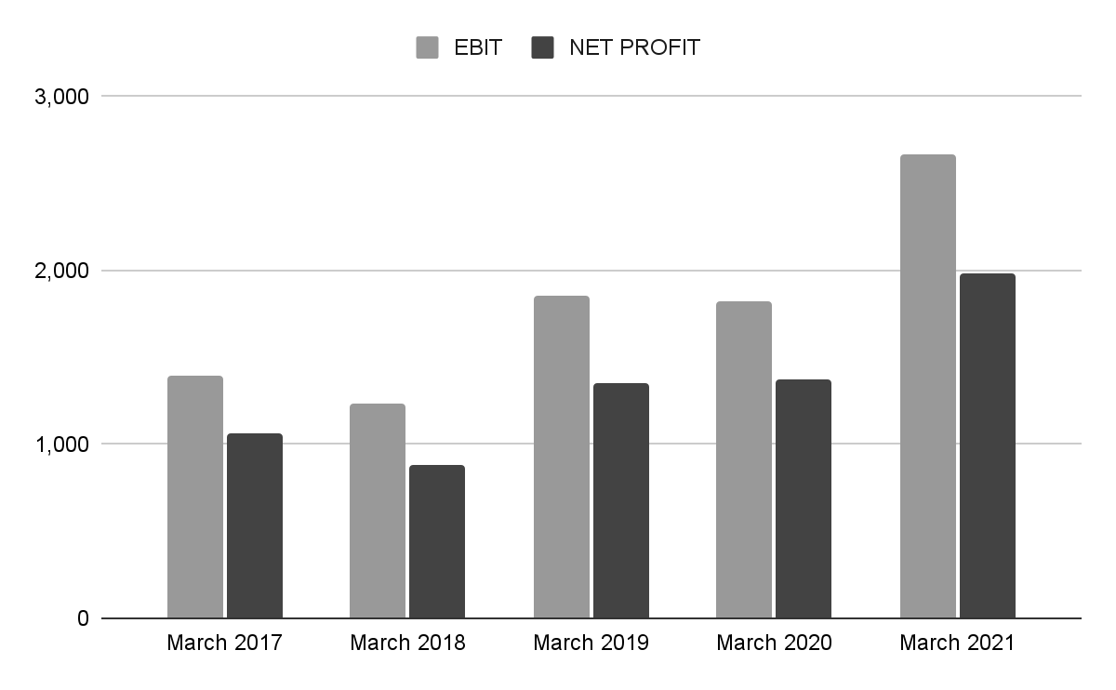
EBIT vs NET PROFIT
SOURCE: Moneycontrol

Slide 12
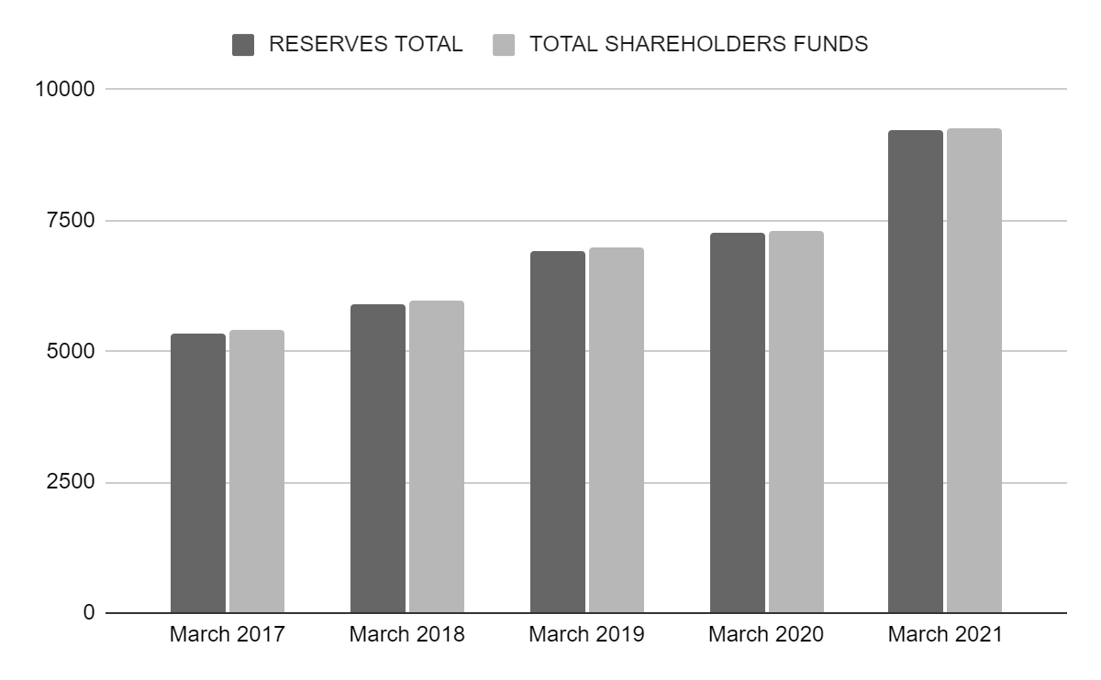
RESERVES TOTAL VS SHAREHOLDER FUNDS
SOURCE: Moneycontrol

Slide 13
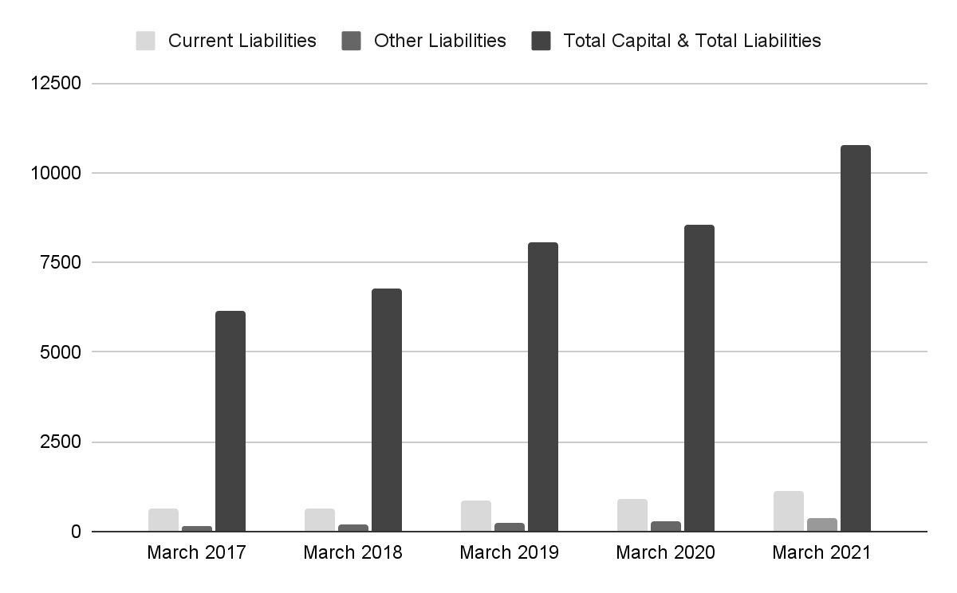
LIABILITIES
SOURCE: Moneycontrol

Slide 14
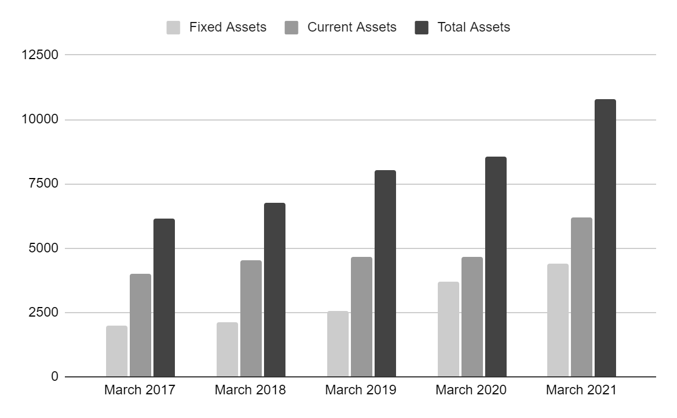
ASSETS
SOURCE: Moneycontrol

Slide 15
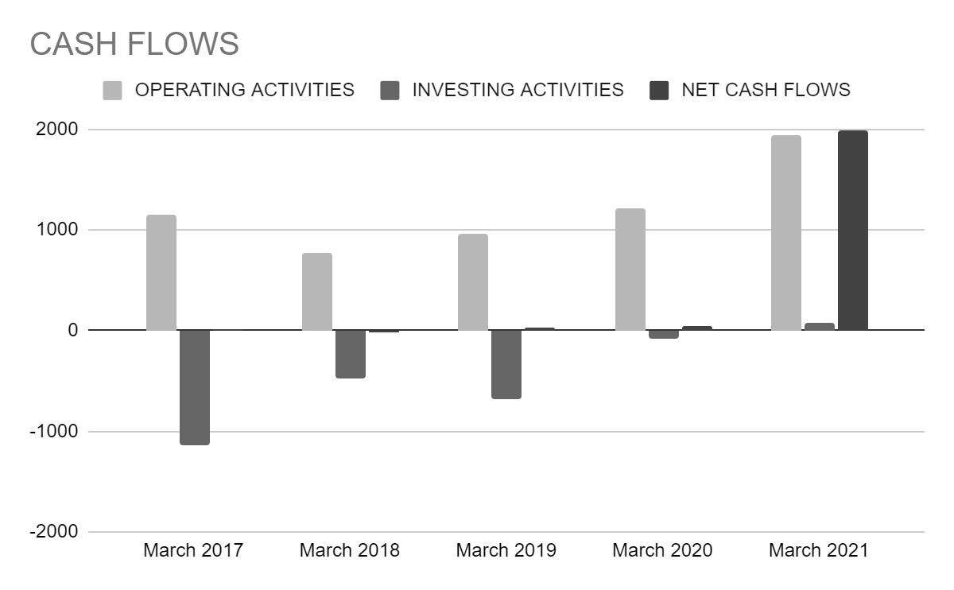
CASH FLOW
SOURCE: Moneycontrol

Slide 16
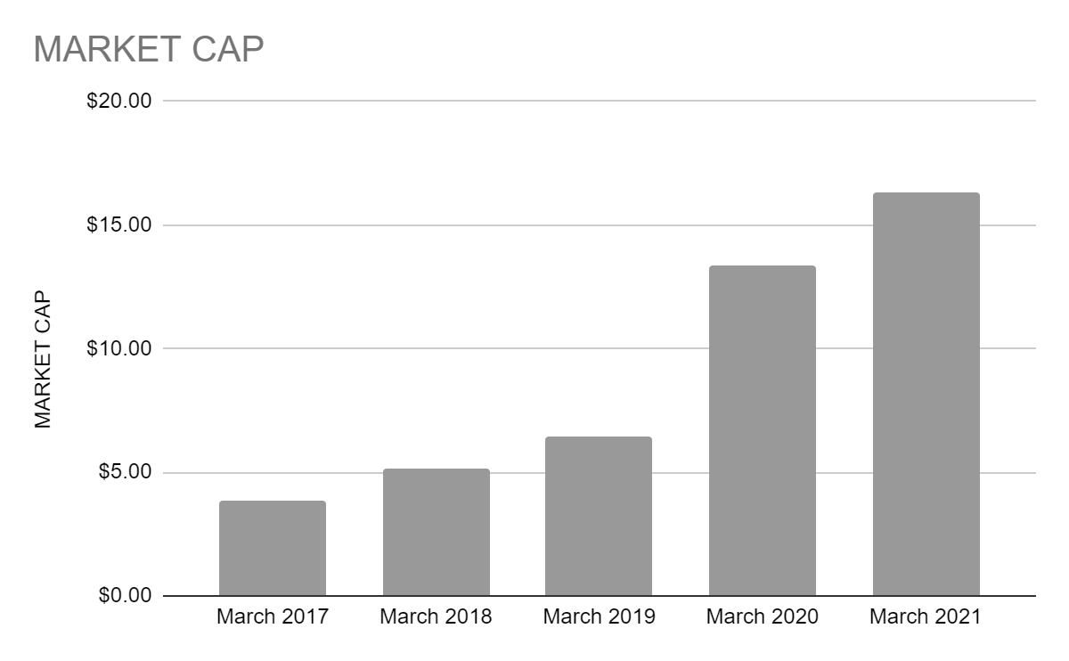
MARKET CAPITALIZATION
SOURCE: Moneycontrol

Slide 17
CONCLUSION
The standalone financial statements, provide the information required by the Companies Act 2013 ("the Act") in the manner required and present a true and fair view of the Company's state of affairs as at March 31, 2021 total comprehensive income (comprising profit and other comprehensive income), changes in equity, and cash flows for the year then ended in accordance with the accounting principles generally accepted in India.

Slide 18
REFERENCES
Some of the references used in the project are:
Investing.com
Moneycontrol
Investopedia
Business Times
Divis Labs
Unsplash

Slide 19

THANK
YOU

